Slide 1
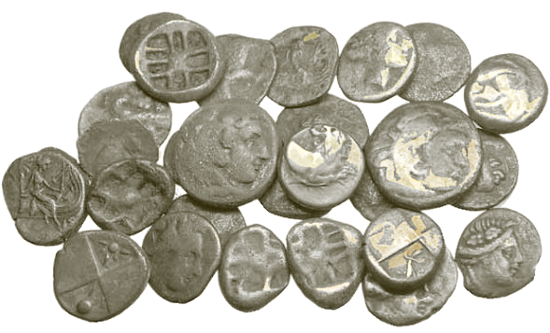
Blood of Jesus
The
The
Blood of Jesus
is Efficacious
is Efficacious
Redemption
Redemption

Slide 2

Ephesians 1:7
In whom we have
redemption
through his blood, the forgiveness of sins, according to the riches of his grace;

Slide 3

BLOODLESS GOSPEL AHEAD
WARNING!

Slide 4

Sunday Evening Church
“
In a recent advertisement of a Sunday evening service:

Slide 5
Sunday Evening Church
1) a high-class movie show,
2) a popular gospel pianist and his wife,
3) and a melody from the opera, "Madame Butterfly," rendered by a well-known Prima Donna.

Slide 6
Sunday Evening Church
…thinks of the Gospel of the Son of God as having so lost its power to draw

Slide 7
Sunday Evening Church
…
an additional attraction to help out our once-crucified and now glorified Savior and Lord.”

Slide 8
Sunday Evening Church
This was in a sermon preached by R.A. Torrey in...
1922

Slide 9
I John 1:9
If we confess our
sins, he is faithful
and just to forgive us our sins, and to cleanse us from all unrighteousness.

Slide 10
Romans 3:25
to declare his
righteousness
for the remission
of sins that are past, through the forbearance of God;
Whom God hath
set forth to be
a propitiation
…through faith
in His Blood…
through
faith in his blood,
…remission of sins that are past…

Slide 11
FAITH-LESS GOSPEL AHEAD
WARNING!

Slide 12

Joseph Prince
“People have said to me,
‘Pastor Prince,
Let us remember again how much we have been forgiven,
and that my future sins are not forgiven
I was taught that only my past sins have been forgiven,
not just of our past sins
You don’t confess your sins to God in order to be forgiven.
until I confess them.’
but of ALL our sins— past, present, and future.

Slide 13

Joseph Prince
Marilin Krug Amen, thank you Lord Jesus.
Sanda Laura Simorangkir Amen
Iyke Vince Thank you Jesus
Merle Headings so true, so true
Hephzibah Hemalatha amen
Hena Kim Amen!!!!!!!
Dolca Gonzalez-Rios Amen!!!1
Beth Ndemi Amen.
Prema Deshen You are awesome LORD, your Love is Amazing
Bosco Otiato Amen...and thanks b t God
Filomeno Escobar Amen!!
Marcio Fortes Amém
Elaine Moore Amen!
William Railey Yes & Amen!!!
Sam Wikotui yes easy to forget in every day life until we are reminded in some way
Sathvika Gurindapalli glory to god...

Slide 14
John 14:6
Jesus
saith unto him,
I am
the way, the truth, and the life: no man cometh unto the Father,
but by me.

Slide 15
CHRIST-LESS GOSPEL AHEAD
WARNING!

Slide 16
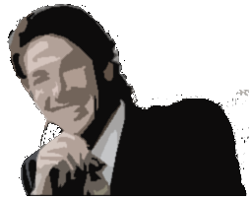

Joe Osteen on Larry King
KING: What if you're Jewish or Muslim, you don't accept Christ at all?
OSTEEN: Well, I don't know if I believe they're wrong. … I've seen their sincerity. So I don't know. I know for me, and what the Bible teaches, I want to have a relationship with Jesus.
June 20, 2005

Slide 17
Blood of Jesus
The
The
Blood of Jesus
is Efficacious
is Efficacious
Redemption
Redemption
end

